Slide 1
Housing
Betting Game

Slide 2
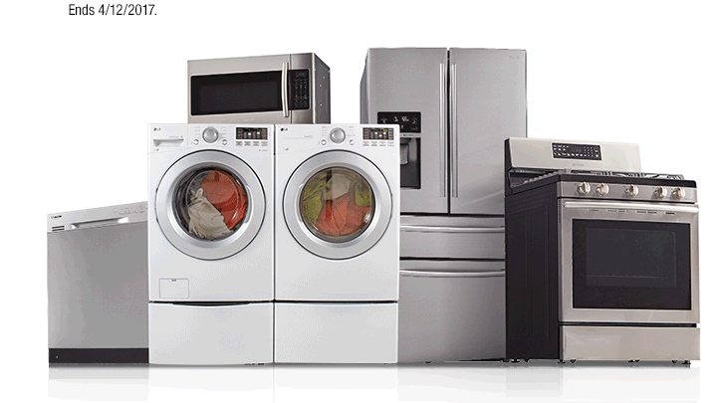
Fridge, stove and dishwasher are all …
a. utilities c. applications
b. landscaping d. Appliances

Slide 3
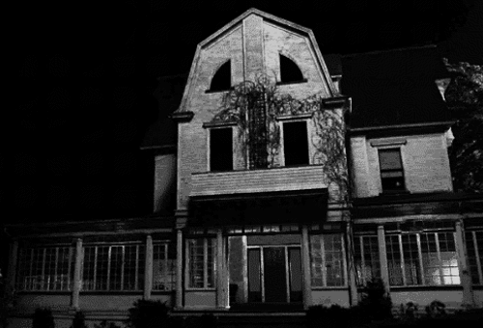
My family has____ gorgeous house. ____ house is near ____ bus stop, ____ restaurants and ____ school. I am going to visit my family ____ next week.
a. a / the / the / the / the / the
b. the / the / a / X / the / the
c. a / the / a / X / the / the
d. a / the / a / X / a / X

Slide 4
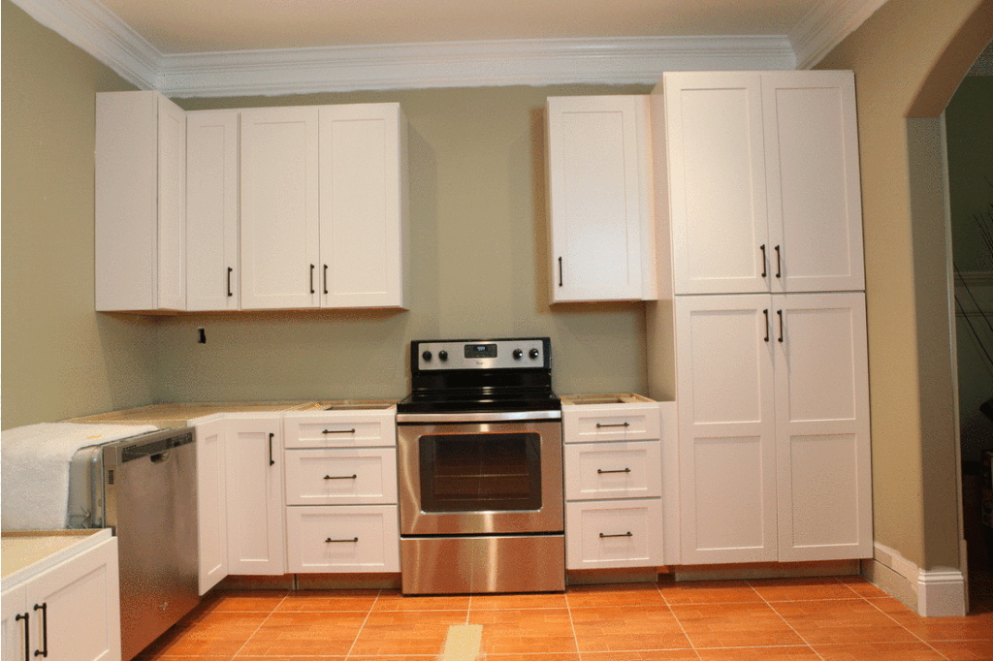
We got lots of new ____ last week. There are some ____ the wall, ____ the counter and _____ the stove.
a. Countertops / in / on / next to
b. Cabinets / on / above / next to
c. Cabinets / in / above / next
d. Countertops / in front of / on / behind

Slide 5
The new _____ signed a 1 year ____ with the ______.
The apartment is ______ so they don’t need to buy any ___.
a. Tenants / lease / landlord / fully furnished / furniture.
b. Landlady / ocupancy / tenants / rennovated / furniture.
c. Tenancy / lease / landlady / furnished / furnishing.
d. Tenants / lease / landlord / unfurnished / furniture.

Slide 6
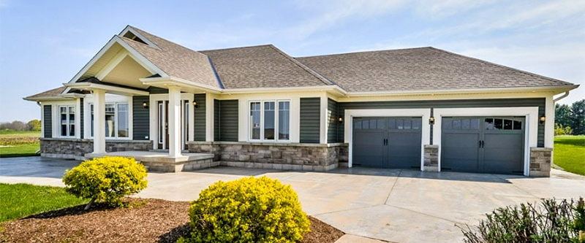
My new bugalow is ____, ____ and ____ than my previous house.
a. more cheaper / more modern / bigger
b. cheaper/ moderner / biger
c. cheaper / more modern / more bigger
d. cheaper / more modern / bigger

Slide 7
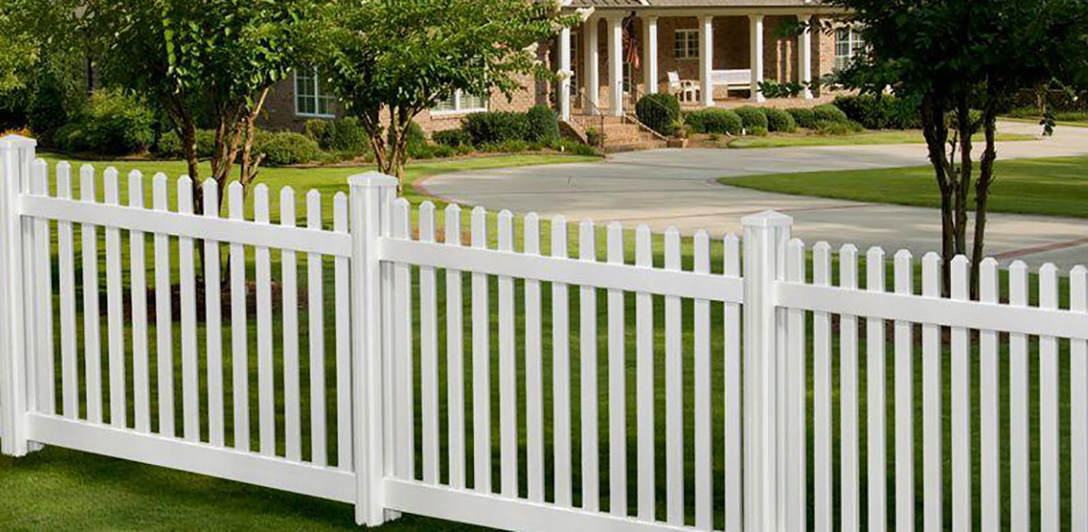
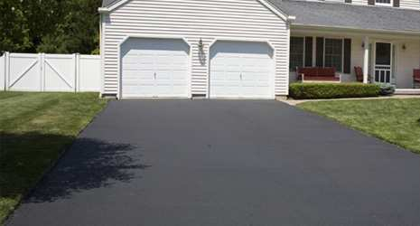
My _____ is white but my _____ is black.
a. Furnace / driveway
b. fence / driveway
c. driveway / walls
d. funce / driveway

Slide 8
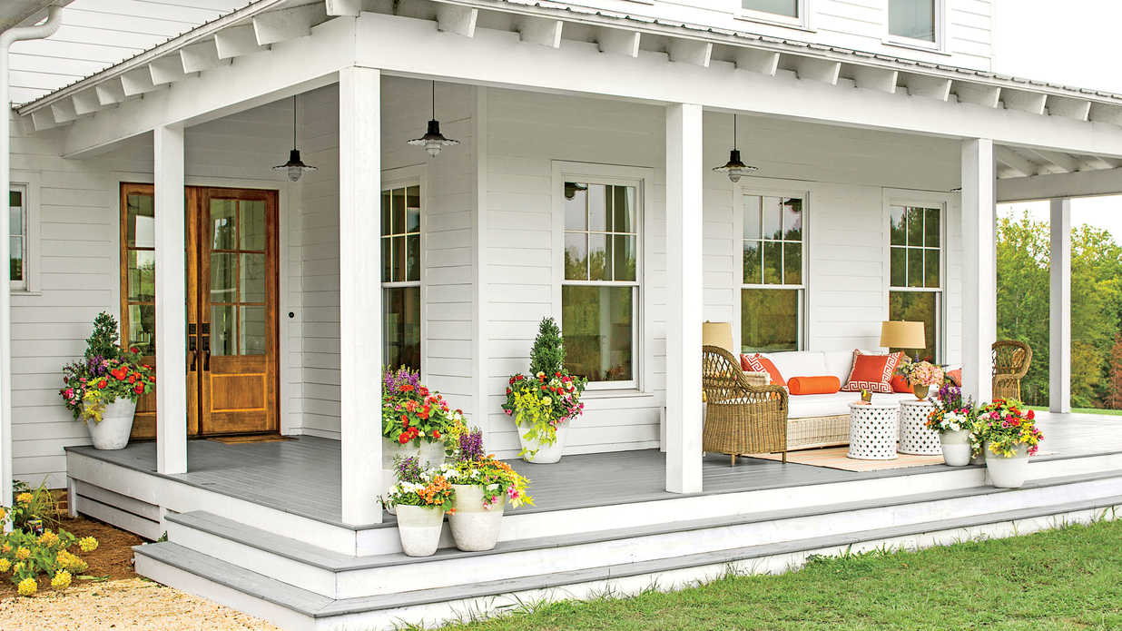
I like having a big _____ in front of my house so that I can sit and drink tea in the mornings.
a. fence
b. landscape
c. porch
d. backyard

Slide 9
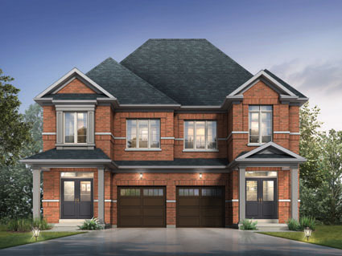
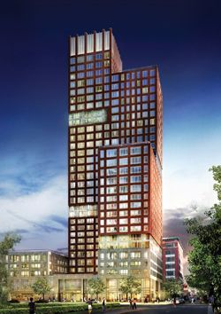
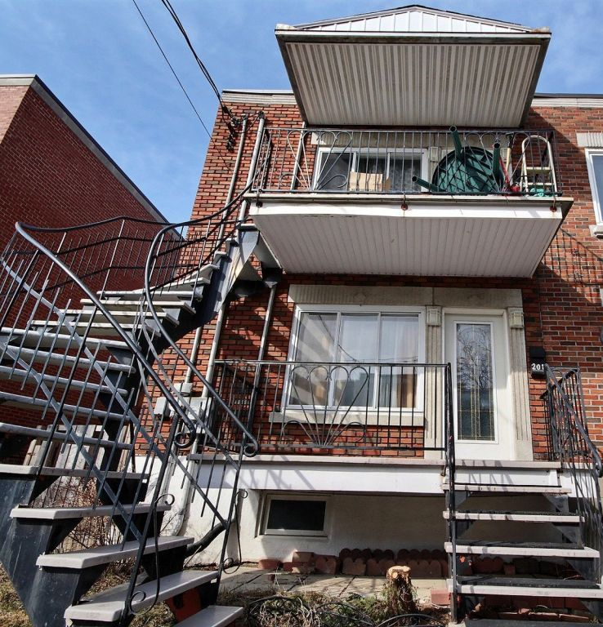
1. _____ 2. _______ 3. _______
a. 1. duplex / 2. mid-rise / 3. townhouse
b. 1. fully-detached / 2. condo / 3. duplex
c. 1. duplex / 2. high-rise / 3. semi-detached
d. 1. Semi-detached / 2. high-rise / 3. duplex

Slide 10
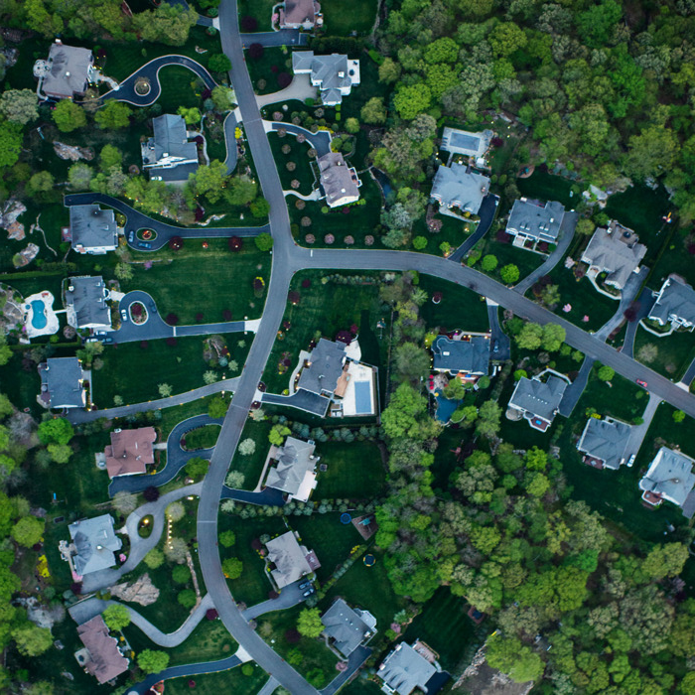
I recently moved to _____.
a. a landscape
b. the city centre
c. the suburbs
d. the amenities

Slide 11
The correct way to ask about the cost of rent.
a. How much is the rent?
b. What is the rent price?
c. How much you pay rent?
d. How much the rent is?

Slide 12
The correct way to ask
about pets.
a. Pets are allowed?
b. Is the apartment pet friendly?
c. I can have pets?
d. Are you allow the pets?

Slide 13
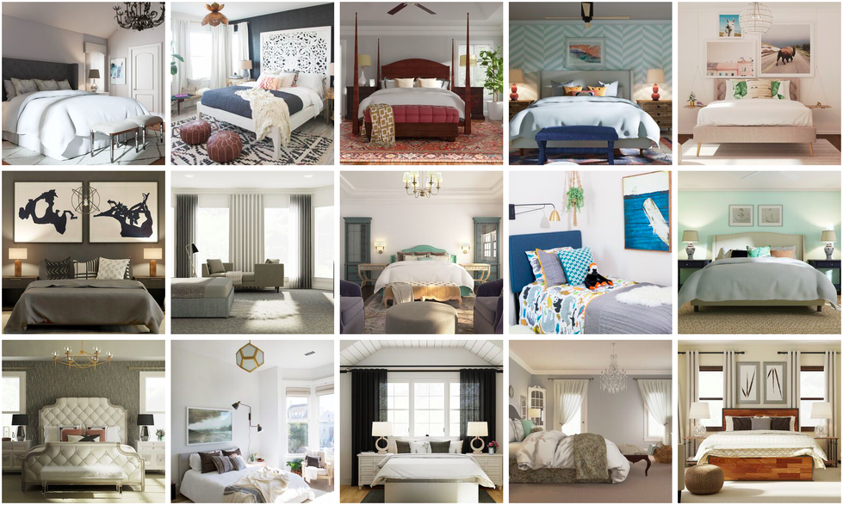
The correct way to ask about # of bedrooms.
a. How many bedrooms does it have?
b. How many bedrooms does it has?
c. How many bedrooms there are?
d. How many bedrooms is there?

Slide 14
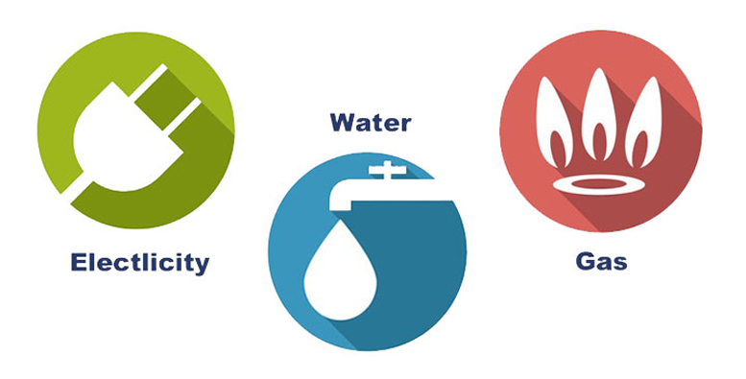
These are called:
a. amenities
b. furnaces
c. appliances
d. utilities

Slide 15
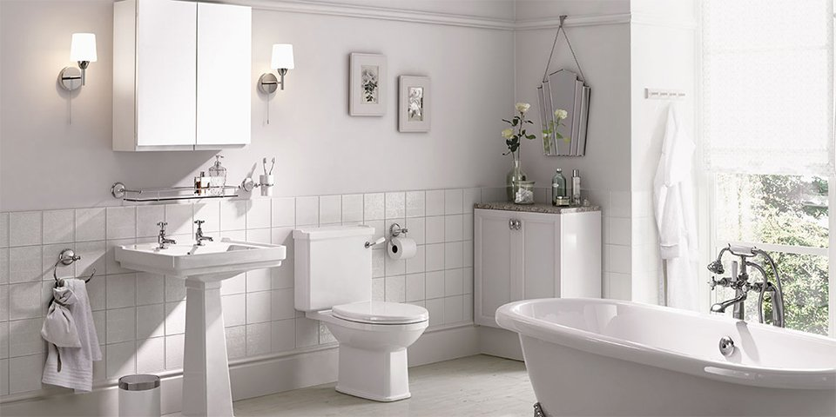
3.
1.
3.
4.
a. 1. bathtub / 2. toilet / 3. roof / 4. shower
b. 1. sink / 2. washroom / 3. ceiling / 4. bathtub
c. 1. sunk / 2. toilet / 3. ceiling / 4. shower
d. 1. sink / 2. toilet / 3. ceiling / 4. bathtub

Slide 16
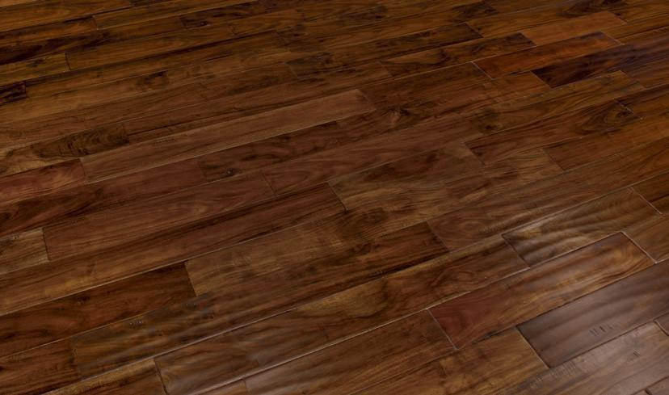
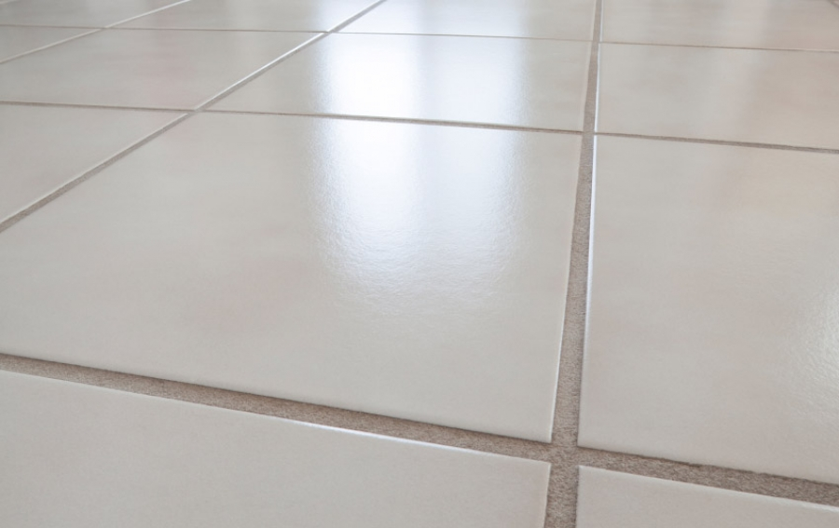
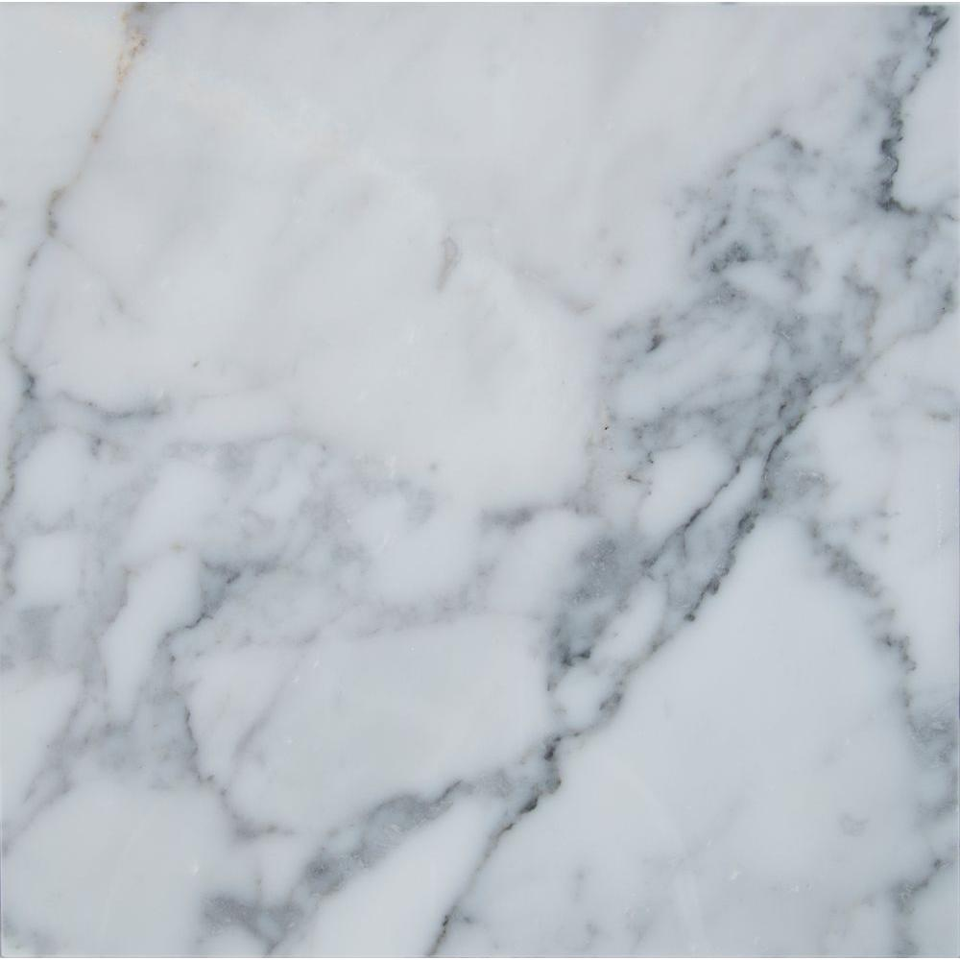
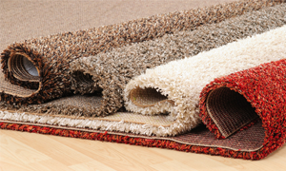
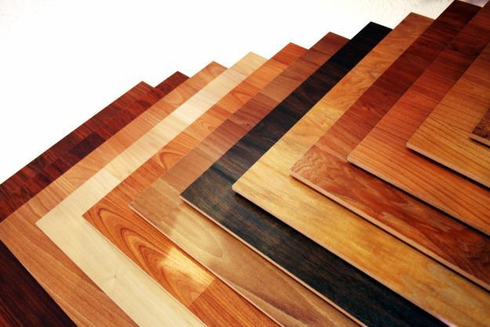
1.
3.
5.
2.
4.
a. 1. hardwood / 2. carpeting / 3. tiles / 4. laminate / 5. marble
b. 1. marble / 2. laminate / 3. tiles / 4. hardwood / 5. Quartz
c. 1. hardwood / 2. carpeting / 3. Quartz / 4. tiles / 5. marble
d. 1. softwood / 2. blinds / 3. tiles / 4. plastic / 5. granite

